Slide 1


FINANCIAL RISK MANAGEMENT AND ENGINEERING
Session 1: Course Overview and Types of Financial Risks

Slide 2
Learning Objectives
By the end of this session, you will be able to:
1. Describe the goals, process, and governance of financial risk management
2. Identify and distinguish the six risk categories: market, credit, liquidity, operational, systemic, ESG/climate
4. Understand the three-assignment portfolio exam and how each session feeds it
5. Acquire and inspect real market data for your own exam portfolio

Slide 3
What Is Financial Risk?
Financial risk arises whenever the future value of an asset, liability, or cash flow is uncertain.
• Risk = uncertainty about future outcomes that affect financial value
• Two dimensions: probability of loss × magnitude of loss
• Risk is not inherently bad.
  There is a trade-off between risk and expected return
  The higher the risk, the higher the expected return
  No risk -> risk-free return
• Risk management: identify, measure, monitor, and control risk
• Key question: which risks are worth taking, and at what price?
Notes:
Stress the risk-return trade-off (Hull Ch.1). Risk is priced; the job is not to eliminate it but to take the right risks knowingly and be paid for them.

Slide 4
Risk and Return
Suppose government bond yield (risk-free rate) is 2% and the values of two equity investments are as following. Both cost DKK100 today.
Which asset has higher risk/return?
Which is a better investment?
Scenario | Probability | Asset 1 Ending Value | Asset 2 Ending Value
Excellent | 0.4 | 120 | 125
OK | 0.4 | 105 | 112
Bad | 0.2 | 100 | 95
Notes:
Asset 1 (ending values 120 / 105 / 100; probabilities 0.40/0.40/0.20)
Returns: +20%, +5%, 0%
E[R₁] = 0.40(20) + 0.40(5) + 0.20(0) = 8 + 2 + 0 = 10.0%
Var₁ = 0.40(20−10)² + 0.40(5−10)² + 0.20(0−10)² = 0.40(100) + 0.40(25) + 0.20(100) = 40 + 10 + 20 = 70
σ₁ = √70 = 8.37%
Asset 2 (ending values 125 / 112 / 95; probabilities 0.40/0.40/0.20)
Returns: +25%, +12%, −5%
E[R₂] = 0.40(25) + 0.40(12) + 0.20(−5) = 10 + 4.8 − 1 = 13.8%
Var₂ = 0.40(25−13.8)² + 0.40(12−13.8)² + 0.20(−5−13.8)² = 0.40(125.44) + 0.40(3.24) + 0.20(353.44) = 50.18 + 1.30 + 70.69 = 122.16
σ₂ = √122.16 = 11.05%
Sharpe ratio = (E[R] − R_f) / σ, with R_f = 2%
Asset 1: (10.0% − 2%) / 8.37% = 8.0 / 8.37 = 0.956
Asset 2: (13.8% − 2%) / 11.05% = 11.8 / 11.05 = 1.068

Slide 5
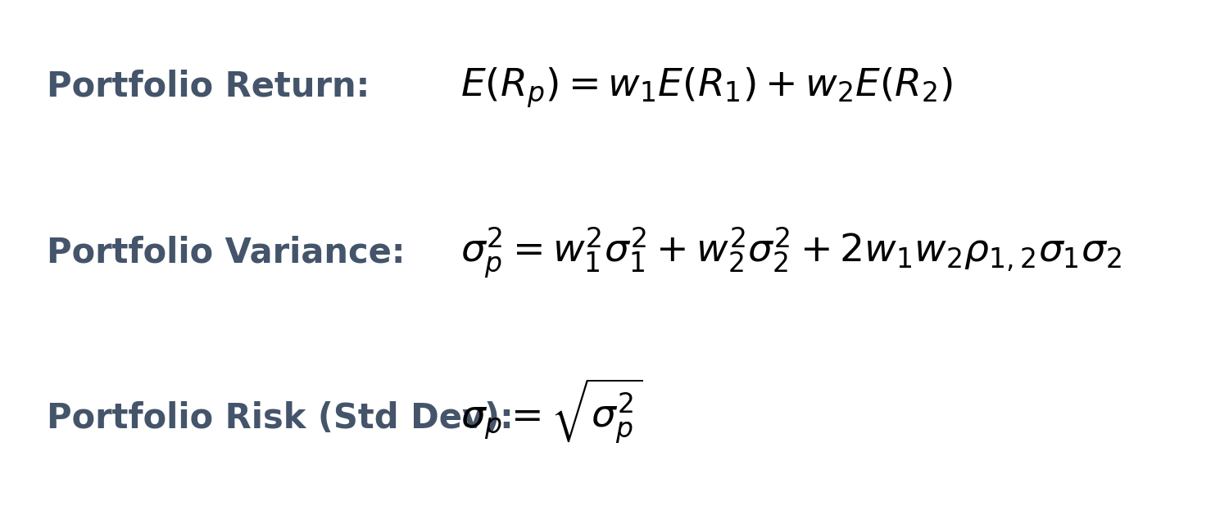
Portfolio Risk and Return
Now, let’s combine the assets in a portfolio:
w1 (Asset 1) | w2 (Asset 2) | Expected Return (%) | Risk / Std Dev (%)
0 | 1 | 13.8 | 11.05
0.2 | 0.8 | 13.04 | 9.48
0.4 | 0.6 | 12.28 | 8.28
0.6 | 0.4 | 11.52 | 7.62
0.8 | 0.2 | 10.76 | 7.65
1 | 0 | 10 | 8.37

Slide 6
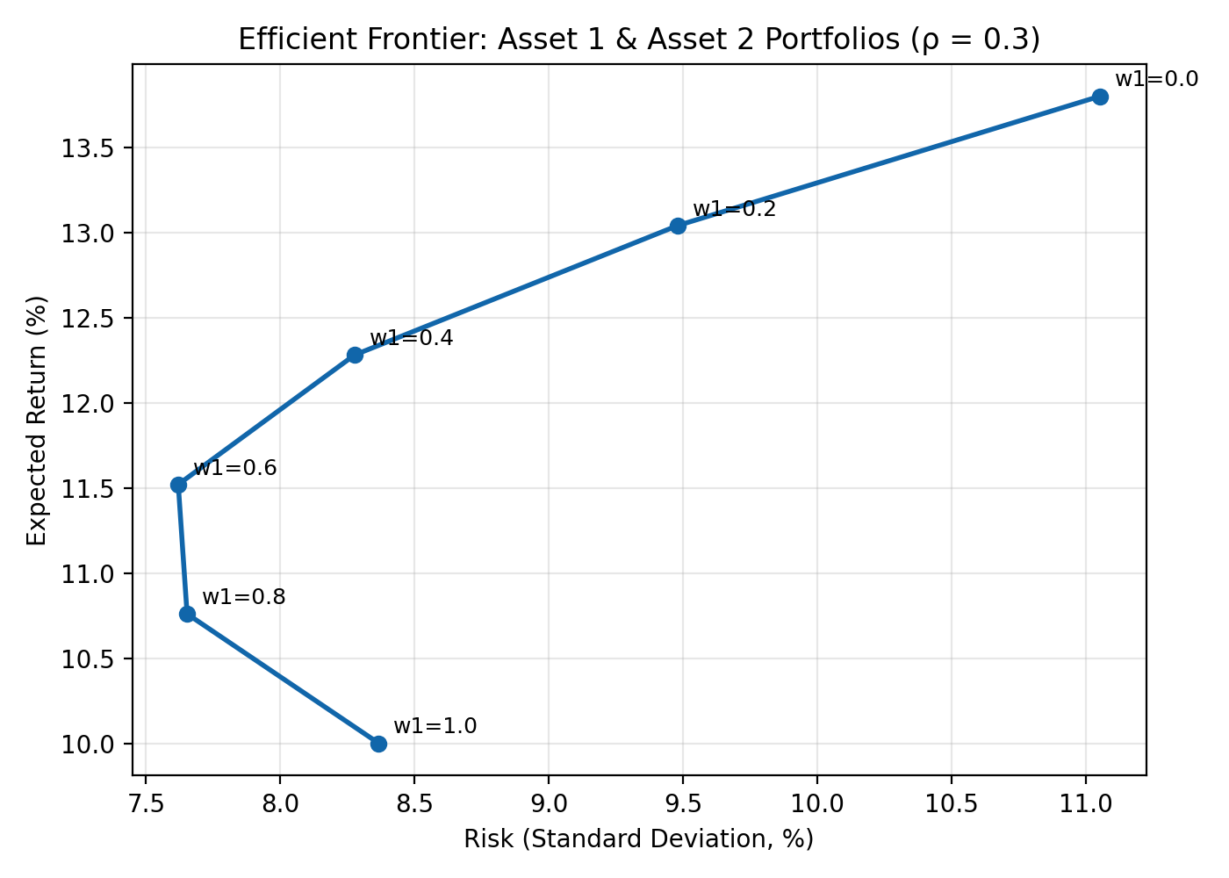
Portfolio Efficient Frontier

Slide 7
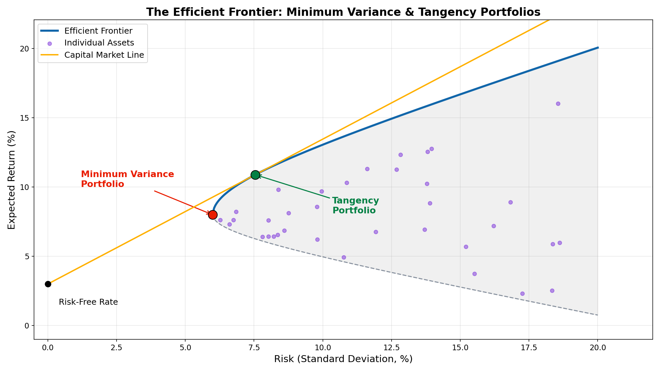
Efficient Frontier for Many Assets

Slide 8
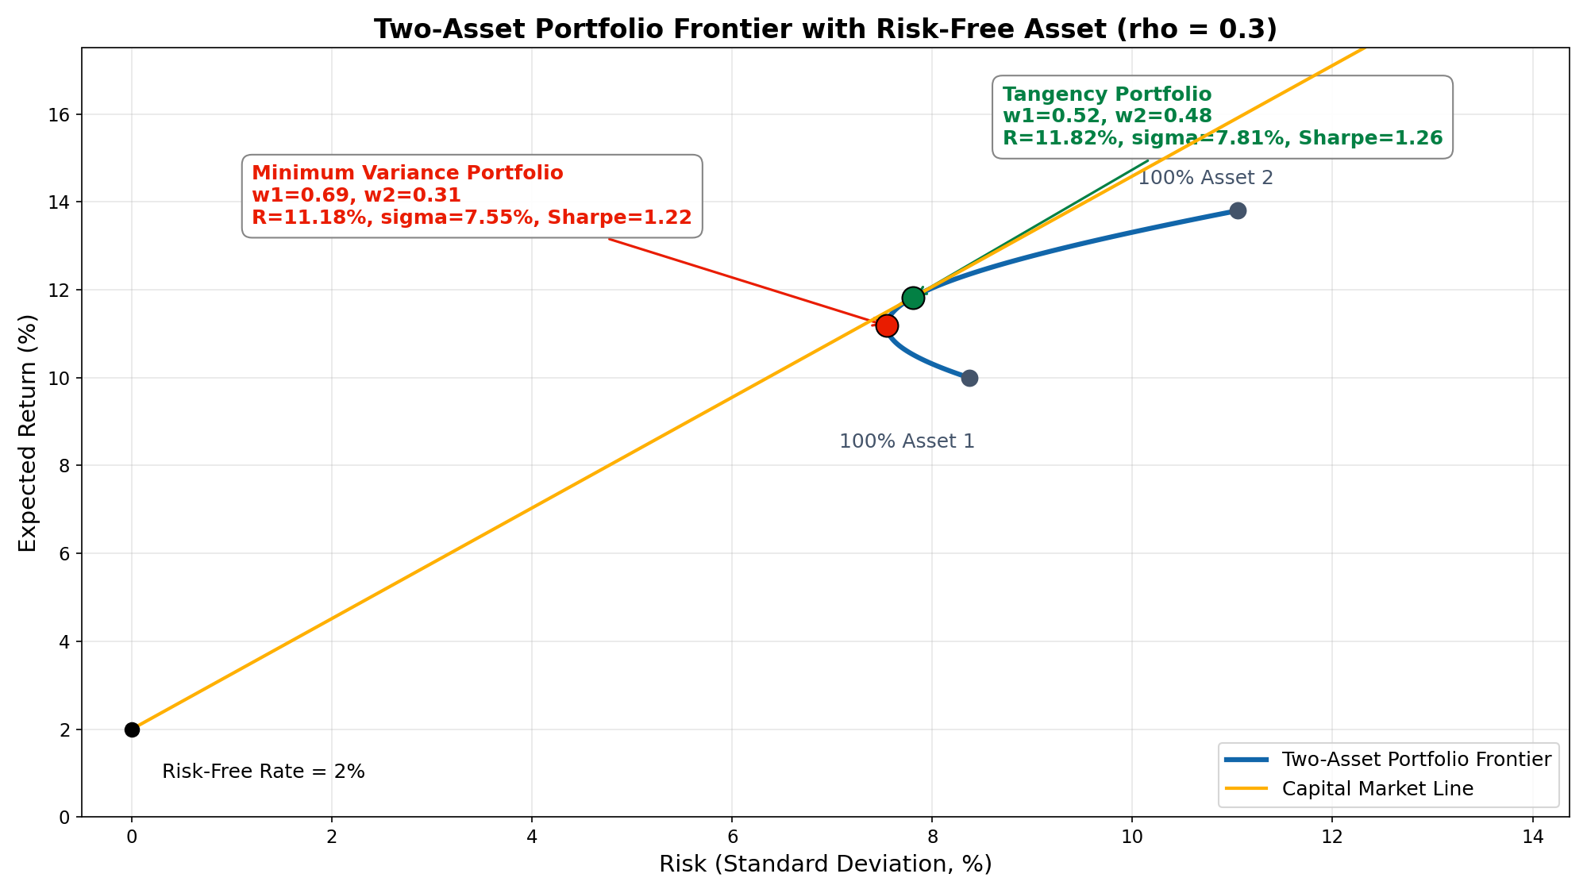
Efficient Frontier for Two Assets
Notes:
Minimum Variance Portfolio (MVP)
w₁ (Asset 1) = 0.69, w₂ (Asset 2) = 0.31
E[R] = 11.18%, σ = 7.55%
Sharpe ratio = (11.18 − 2) / 7.55 = 1.22
Tangency Portfolio
w₁ (Asset 1) = 0.52, w₂ (Asset 2) = 0.48
E[R] = 11.82%, σ = 7.81%
Sharpe ratio = (11.82 − 2) / 7.81 = 1.26 (highest attainable Sharpe ratio on the two-asset frontier)

Slide 9
The Risk Management Process
1 Identify
2 Measure
Map all risk exposures
Risk register & heat map
Qualitative + quantitative
Include tail & scenario risks
Quantify via models & data
VaR, ES, credit metrics
Sensitivity analysis
Stress tests & Monte Carlo
3 Monitor
4 Control
Track exposures over time
Dashboards & limit checks
Early-warning indicators
Backtest model accuracy
Hedging & derivatives
Position limits & stop-losses
Capital allocation (RAROC)
Governance & regulation
Notes:
This identify-measure-monitor-control cycle is the spine of the whole course: measure = Sessions 2-8, control/optimise = Sessions 9-11, monitor/backtest threads through.

Slide 10
Why Risk Management Matters
Historical Failures
GFC 2008: tail risk & contagion underestimated
LTCM 1998: leverage + model risk; ~$4.6B loss
Barings 1995: rogue trader (Leeson); ~$1.3B
Enron 2001: accounting & off-balance-sheet risk
JPMorgan 'London Whale' 2012: ~$6.2B
Key Lessons
Models have limits - validate and stress-test
Tail risks become correlated in crises
Culture and governance matter as much as models
Leverage amplifies every type of risk
Disclosure reduces systemic fragility
Notes:
Stress the risk-return trade-off (Hull Ch.1). Risk is priced; the job is not to eliminate it but to take the right risks knowingly and be paid for them.

Slide 11
Market Risk & Credit Risk (Two Major Risks)
Market risk:
Loss from market-price movements
Equity, FX, interest-rate, commodity risk
Measured by VaR, ES, Greeks, DV01
Basel III FRTB: 97.5% ES replaces VaR
Models: GARCH, historical sim, Monte Carlo
Credit risk:
Counterparty fails to meet obligations
Expected loss = PD × LGD × EAD
Unexpected loss drives regulatory capital
Structural (Merton) & intensity models
Ratings: S&P, Moody's, Fitch
Notes:
Stress the risk-return trade-off (Hull Ch.1). Risk is priced; the job is not to eliminate it but to take the right risks knowingly and be paid for them.

Slide 12
Liquidity Risk & Operational Risk
Liquidity risk:
Market liquidity: cannot exit without price impact
Funding liquidity: cannot meet obligations when due
Amihud illiquidity ratio; bid-ask spread
Liquidity Coverage Ratio (LCR) ≥ 100%
Net Stable Funding Ratio (NSFR) ≥ 100%
Operational risk:
Failed processes, people, systems, external events
Fraud, cyber, legal & compliance failures
Basel II: BIA / TSA / AMA approaches
Basel III final: single Standardised Approach
Modelled with Poisson frequency × lognormal severity
Notes:
Stress the risk-return trade-off (Hull Ch.1). Risk is priced; the job is not to eliminate it but to take the right risks knowingly and be paid for them.

Slide 13
Systemic Risk & ESG/Climate Risk
Systemic risk:
CoVaR: VaR of the system given firm i is in distress
ΔCoVaR: firm i's incremental contribution to system risk
SRISK (Brownlees & Engle 2017): expected capital shortfall in a crash
MES: a firm's average loss on the market's worst days
Individually rational behaviour can be collectively destructive
ESG/Climate risk:
Loss from environmental, social & governance factors
Physical risk: floods, droughts, wildfires, sea-level rise
Transition risk: policy, carbon pricing, stranded assets
Long-horizon, correlated, hard to model - diversification limited

Slide 14
ESG & Climate Risk
ESG and climate risk are now treated as mainstream by the FSB, ECB, and Bank of England.
• Physical risk: floods, droughts, wildfires, sea-level rise
• Transition risk: policy, carbon pricing, stranded assets
• Liability risk: claims against high-emitters and their financiers
• Disclosure: TCFD, EU taxonomy, IFRS S1/S2 (ISSB), SEC climate rule
• 'Green Swan' (BIS 2020): unprecedented, hard-to-model climate tail risk
• ESG ratings disagree across providers - measurement is itself a risk
Notes:
Connects to Assignment 3's ESG tilt, where students deliberately use two rating providers to show how ESG-score disagreement (Berg et al. 2022) changes their portfolio.

Slide 15
Comparing the Six Risk Categories
Market & Credit
Liquidity
Most quantified; longest history
Basel capital charges well established
VaR, ES, PD/LGD/EAD models
Hard to model; highly non-linear
Crises amplify all other risks
LCR / NSFR are post-GFC tools
Operational
Systemic & ESG
Non-financial origin; data scarce
Fat-tailed loss distribution
Culture & governance paramount
Macro-level; network externalities
Contagion & fire-sale spirals
ESG newest; data still evolving
Notes:
Punchline: quantifiability decreases left to right, but importance does not. The newest categories are the least modellable, and that gap is itself model risk.
'In 2008, mortgage-backed securities lost value simultaneously: primarily market, credit, or systemic risk?' Listening for: it started as credit, was amplified by liquidity, and became systemic - real events rarely fit one box.

Slide 16
Nature of Banking
Commercial banking
  Taking deposits, making loans (wholesale or retail)
  Money center banks operate in the wholesale market and often fund loans by borrowing
Investment banking
  Raising debt and equity for companies; advice on mergers and acquisitions, restructurings, trading, etc

Slide 17
Example of Simple Bank Balance Sheet (2025)
Assets | (mln. $) | Liabilities | (mln. $)
Cash | 5 | Deposits | 90
Marketable Securities | 10 | Long-Term Debt | 5
Loans | 80 | Equity | 5
Fixed Assets | 5
TOTAL | 100 | TOTAL | 100

Slide 18
Income Statement (2025)
Income Statement | (mln. $)
Net Interest Income | 3
Provision for Loan Losses | -0.8
Non-Interest Income | 0.9
Non-Interest Expense | -2.5
Pre-tax Income | 0.6
What happens in year 2026 if it is the same as year 2025 except that provision for loan losses is 4.0 instead of 0.8?

Slide 19
How the 6 Risks affect the Bank
Market risk
Hits: securities (10) marked down; rate rises compress net interest income (3.00)
Manage: duration-gap / ALM, interest-rate swaps, VaR & ES limits
Credit risk
Hits: loan (80) defaults raise loan-loss provisions — 0.80 → 4.00 turns +0.60 into −2.60
Manage: underwriting limits, diversification, collateral, provisioning, capital buffer
Liquidity risk
Hits: only 15 liquid assets vs 90 deposits; runs force fire-sale losses
Manage: HQLA buffers (LCR/NSFR), diversified funding, contingency funding plan

Slide 20
How the 6 Risks affect the Bank
Operational risk
Hits: fraud, cyber, fines land in non-interest expense (2.50)
Manage: internal controls, cyber resilience, insurance, op-risk capital
Systemic risk
Hits: funding, asset values, defaults strike at once — 5 equity too small
Manage: extra capital/liquidity buffers, less concentration, stress tests, resolution plans
ESG / climate risk
Hits: stranded loans → future provisions; physical damage to collateral; liability costs
Manage: climate stress tests, sector exposure limits, decarbonize, price into spreads

Slide 21
What if Balance Sheet Had Been More Aggressive?
Assets | (mln. $) | Liabilities | (mln. $)
Cash | 5 | Deposits | 94
Marketable Securities | 10 | Long-Term Debt | 5
Loans | 80 | Equity | 1
Fixed Assets | 5
TOTAL | 100 | TOTAL | 100

Slide 22
Regulation
Regulators set minimum levels for the capital a bank is required to keep
Equity is an example of Tier 1 capital
Subordinated long term debt is an example of Tier 2 capital

Slide 23
Deposit Insurance
Most countries have deposit insurance programs that insure depositors against losses up to a certain level
In the US the FDIC has provided protection for depositors since 1933
The amount insured was $2,500 in 1933
It has been increased several times
Following the credit crisis it was increased from $100,000 to $250,000 in October 2008.
Why might deposit insurance encourage a bank to take risks?

Slide 24
Long-Term Capital Management (LTCM): What Happened
The firm
Long-Term Capital Management: hedge fund founded 1994 by John Meriwether (ex-Salomon bond arbitrage)
Star partners: Nobel laureates Robert Merton and Myron Scholes, plus former Fed Vice Chairman David Mullins
The strategy
Relative-value / convergence arbitrage: buy the cheap bond, short the rich one, profit when prices converge
Mispricings were tiny (a few basis points), so returns had to be manufactured with enormous leverage
The leverage
Early 1998: about 4.7bn USD equity supporting about 125bn USD of assets, roughly 25 to 1
Derivatives pushed notional exposure past 1 trillion USD, so true economic leverage was far higher
Early returns dazzled: about 40% in 1995 and 1996, feeding confidence in the firm and its lenders
The trigger
Aug 17, 1998: Russia devalued the ruble and defaulted on its domestic debt, an event models rated near-impossible
Flight to quality: spreads LTCM bet would narrow instead widened sharply
Notes:
LTCM is the classic risk-management failure to open with. The set-up is the irony: the best minds in finance, Nobel laureates and a former Fed official, still blew up. The strategy was sound in isolation - convergence arbitrage - but only paid pennies, so they levered ~25x on the balance sheet and far more through derivatives. Emphasise that leverage is the amplifier: it turns a small, survivable loss into insolvency. The trigger was the Russian default, a tail event the models treated as effectively impossible.

Slide 25
LTCM: Why It Failed and What It Teaches
The collapse
Bets assumed to be independent all moved together: correlations went to 1 exactly when it mattered
Positions were too large to exit - LTCM was the market - so unwinding meant fire-sale prices (liquidity risk)
About 1.9bn USD lost in Aug 1998 alone, roughly half its capital; equity fell from 4.7bn to under 1bn in weeks
The rescue
Sep 1998: the New York Fed convened 14 banks to inject about 3.6bn USD for 90% of the fund
Private-sector money, not a taxpayer bailout; a disorderly unwind of >1tn USD threatened to freeze markets
An early lesson in systemic risk: one fund was too interconnected to fail through its counterparties
Risk-management lessons
Leverage is the amplifier: a sound strategy at 2 to 1 becomes lethal at 25 to 1
Correlations rise toward 1 in a crisis; diversification measured in calm markets overstates protection
Liquidity risk is distinct from market risk; VaR calibrated on quiet data underprices fat tails
Ties to market, liquidity, systemic and model risk - brilliance is not a hedge
Notes:
The failure was structural, not a lack of intelligence: leverage + liquidity + correlation. The three killers, in order: (1) diversification evaporated because correlations went to 1; (2) they could not exit because they WERE the market - pure liquidity risk that VaR ignores; (3) 25x leverage converted a bad month into insolvency. The Fed-coordinated private rescue is the systemic-risk / too-interconnected-to-fail angle, a direct precursor to 2008. Close by mapping LTCM onto the six risk types from earlier in the session. Reading: Lowenstein, When Genius Failed.

Slide 26
Course Roadmap
• S1 Course overview & the six types of financial risk
• S2 Market-risk basics: returns, volatility, correlation
• S3 Value-at-Risk: parametric, historical, Monte Carlo
• S4 Expected Shortfall & back testing
• S5-6 Credit risk: Merton & spreads; intensity & portfolio copula models
• S7 Liquidity & operational risk
• S8 Derivatives in risk management: binomial & Black–Scholes
• S9-10 Portfolio risk & optimization: mean-variance; risk parity, robust, ESG
• S11 Regulatory risk & stress testing (Basel III)
• S12 Systemic risk & model risk
• S13 Review — key topics & exam Q&A
Notes:
Point to the colour grouping of the exam map next: S2-4 = Assignment 1, S5-8 = Assignment 2, S9-12 = Assignment 3.

Slide 27
The Portfolio Exam
Assessment is one portfolio exam — three assignments you build across the course and finalise after collective feedback on your drafts.
• Three individual assignments, equally weighted; everyone's portfolio differs
• Deliverable: one executable Jupyter notebook (.ipynb) + PDF export + your data snapshot
• Submit via WISEflow; graded on the Danish 7-point scale
• Length: ≤10,000 narrative characters per assignment (code & figures excluded); ≤30,000 total
• Attendance: 11 days required to be eligible to sit the exam
• AI/LLM tools (ChatGPT, Claude) are permitted and encouraged — verify every number against your own output
• Marked on correct method and interpretation of YOUR results, not code volume
Notes:
AI is allowed but it cannot see their data and invents numbers; the marks are in interpretation and limitations (50% of the rubric combined). Tight writing wins.

Slide 28
How the Course Builds Your Exam
Assignment 1 · Market Risk
Assignment 2 · Credit, Deriv., Liq., Op.
Sessions 2–4
Volatility, correlation, beta
VaR: parametric / historical / MC
Expected Shortfall; GARCH(1,1)
Basel traffic-light backtest
Sessions 5–8
Merton distance-to-default & PD
Gaussian-copula Credit VaR
Black–Scholes / binomial Greeks
Liquidity-adj. VaR; op-loss sim
Assignment 3 · Optimisation & Systemic
Across board
Sessions 9–12
Mean-variance frontier; risk parity
Black–Litterman; robust/shrinkage
ESG tilt; stress tests (Basel III)
CoVaR; 1/N out-of-sample test
Real-data acquisition (yfinance)
Reproducible snapshot, clean data
Interpretation anchored to YOUR numbers
Critical limits & regulatory framing

Slide 29
Acquiring Your Own Data
• Stock 1: a listed company starting with your FIRST-name initial
• Stock 2: a listed company starting with your LAST-name initial
• Stock 3: a different sector, so the portfolio is diversified
• Single-bloc rule: all three trade in one bloc, benchmarked to that bloc's index
◦ North America → S&P 500 (^GSPC); all-Canadian → S&P/TSX (^GSPTSE)
◦ Europe incl. UK → STOXX Europe 600 (^STOXX); all-London → FTSE 100 (^FTSE)
• Why one bloc: beta is only meaningful within one trading calendar & currency area
• Verify in Python: ≥3 years daily history, plus market cap & total debt (Assignment 2)
• Reproducibility: pin an end-date, download once, save a CSV snapshot
• ★ DO IT NOW: write down YOUR three tickers + bloc index - they are your lab universe today and your exam portfolio all term
Notes:
Walk one worked example, e.g. a student 'Maria Nielsen' -> a 'M' stock, an 'N' stock, a third in a different sector, all European, benchmarked to ^STOXX. Stress the snapshot for reproducibility - their narrative numbers must match the saved data.

Slide 30
Working in Jupyter: Habits & Quick Fixes
The four habits and four fixes that save the most hours. The full table lives in the Getting-Started primer.
• Run cells top to bottom - order matters; when in doubt, Kernel ▸ Restart & Run All
• Tab = autocomplete; Shift+Tab inside () shows a function's arguments
• A variable alone on the last line prints it; display(df) for pretty tables
• Markdown cells for notes & math — the exam is graded on explanation, not code
• ModuleNotFoundError → pip install <name>, then restart the kernel
• NameError → you skipped the cell that defines it; run from the top
• yfinance returns nothing → rate limit; the cached CSV snapshot makes you immune
• Stuck? Read the LAST line of the traceback first — then paste it into the AI
Notes:
The single biggest beginner bug is out-of-order execution - teach Restart & Run All as the reflex before trusting any result (and before submitting the exam). Remind them AI can write code but cannot see their data, so it invents numbers - the snapshot + Restart & Run All is how they catch that. Everything else (full error table, keyboard shortcuts, editor setup) is in the primer they already have.

Slide 31
Python Lab
Notebook: Session_01_Risk_Landscape_Notebook.ipynb
Lab Tasks
Discuss
1. Run Blocks 0–1 together: load 5 years of real data; returns, volatility, Sharpe, drawdown
2. Block 2: the fat-tails histogram — how far real returns depart from the normal
3. Block 3: the six risk categories seen in one dataset (heatmap; market vs credit panels)
4. Block 4: the reproducible exam workflow - pin dates, download once, snapshot to CSV
5. 'Your Turn' Part A - download YOUR three exam tickers (picked earlier) + bloc index
6. GOAL before you leave: Part A done — your own data on your own machine, snapshotted
7. Parts B–E (returns, risk picture, reflection) are tonight's homework
8. Optional extra practice: Session_01_Extra_Practice.ipynb (ETF cross-asset version)
Which risk category explains your stocks' extreme days?
How far does your histogram depart from the normal overlay (fat tails)?
This exact workflow IS the opening of Assignment 1 of your exam.

Slide 32
Required Readings & References
Required
Supplementary
• Hull, J. C. (2023). Risk Management and Financial Institutions, 6e. Ch. 1: Introduction — Risk-Return Trade-offs.
• Jorion, P. (2010). Financial Risk Manager Handbook, 6e. Ch. 1: Risk Management.
• Stulz, R. M. (1996). Rethinking risk management. J. Applied Corporate Finance, 9(3), 8–25.
• Manganelli, S., & Engle, R. F. (2001). Value at risk models in finance. ECB WP No. 75.
• TCFD (2017). Recommendations of the Task Force on Climate-related Financial Disclosures. FSB.
• Nocera, J. (2009). Risk mismanagement. New York Times Magazine, 4 Jan 2009.

Slide 33
Session Wrap-Up
Key Takeaways
Next Session
✓ Financial risk spans six categories: market, credit, liquidity, operational, systemic, ESG/climate
✓ Risk management is a cycle — identify → measure → monitor → control — inside a governance structure
✓ Historical failures (GFC 2008, LTCM 1998) and regulation (Basel, TCFD) shape today's practice
✓ Your assessment is a three-assignment portfolio exam built on data you fetch yourself
✓ Python (pandas, NumPy, scipy, arch, yfinance) is our tool throughout — starting today
Session 2: Market Risk Basics
- Simple vs. log returns
- Fat tails & volatility clustering
- EWMA & GARCH(1,1)
- Correlation & copulas
Tonight: 'Your Turn' Parts B–E with your own tickers
Optional: Session_01_Extra_Practice.ipynb
Read: Hull Ch. 8 (Volatility) & Ch. 9 (Correlations and Copulas)

